Slide 1

Finding Potential Brownfields through the Nearest Neighbor Algorithm
Fern Force Five: Erin Wojciechowski, Jacob Orben, Kylie Gorman, Matt Judy, Nate Milkosky, and Thomas Borgia

Slide 2
Overview
Our program takes in coordinates as arguments and creates a test point. Chemicals are then added to the test location based on data of known brownfields in the area. The data of the test point is then output including all chemicals within the first degree of certainty around the test point and certain chemicals in the second degree of certainty.
Front end: User Interface created as an HTML page
Back end: Main bulk of our code that contains all main functionality and returns data to be displayed via the front end

Slide 3
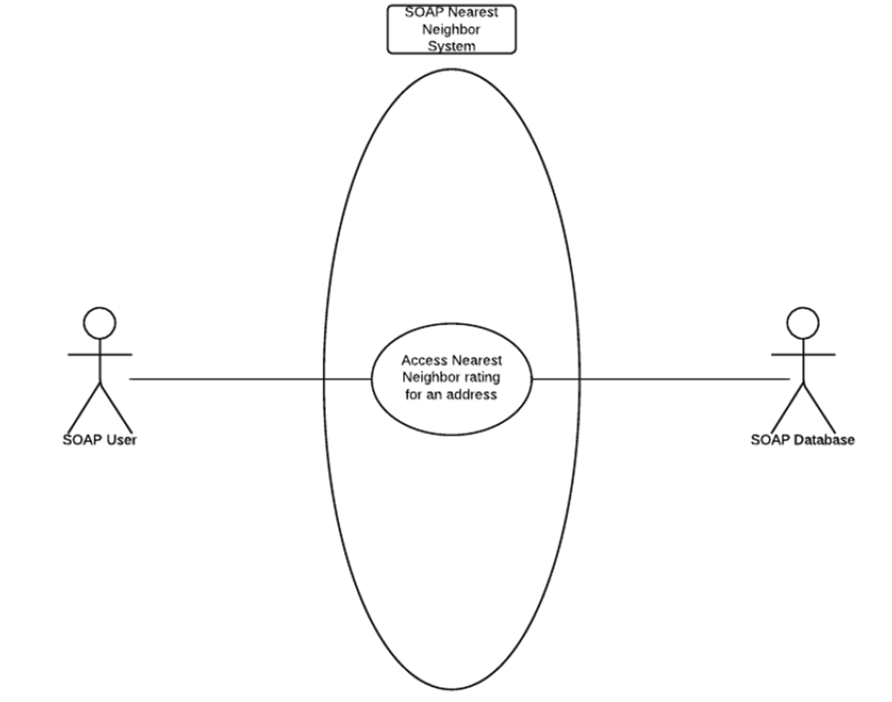

Slide 4
Front end
HTML and PHP
The boxes obtained the user input
The latitude and longitude were passed to the C++ code
The exec function presented the largest challenge
The result was passed back to the interface

Slide 5
The Exec Function
Connects front end to back end
string exec ( string $command, array &$output, $return_var)
Command
Output
Return

Slide 6
Back end
Made up of 3 classes and a driver
Algorithm class-calculates and determines which chemicals are likely to be at the test point.
Chemical class-contains functions for Chemical objects and attributes of those chemicals including a name, a danger rating, CAS number, and total releases.
Location class-contains function for location objects that hold data for a given test point.

Slide 7
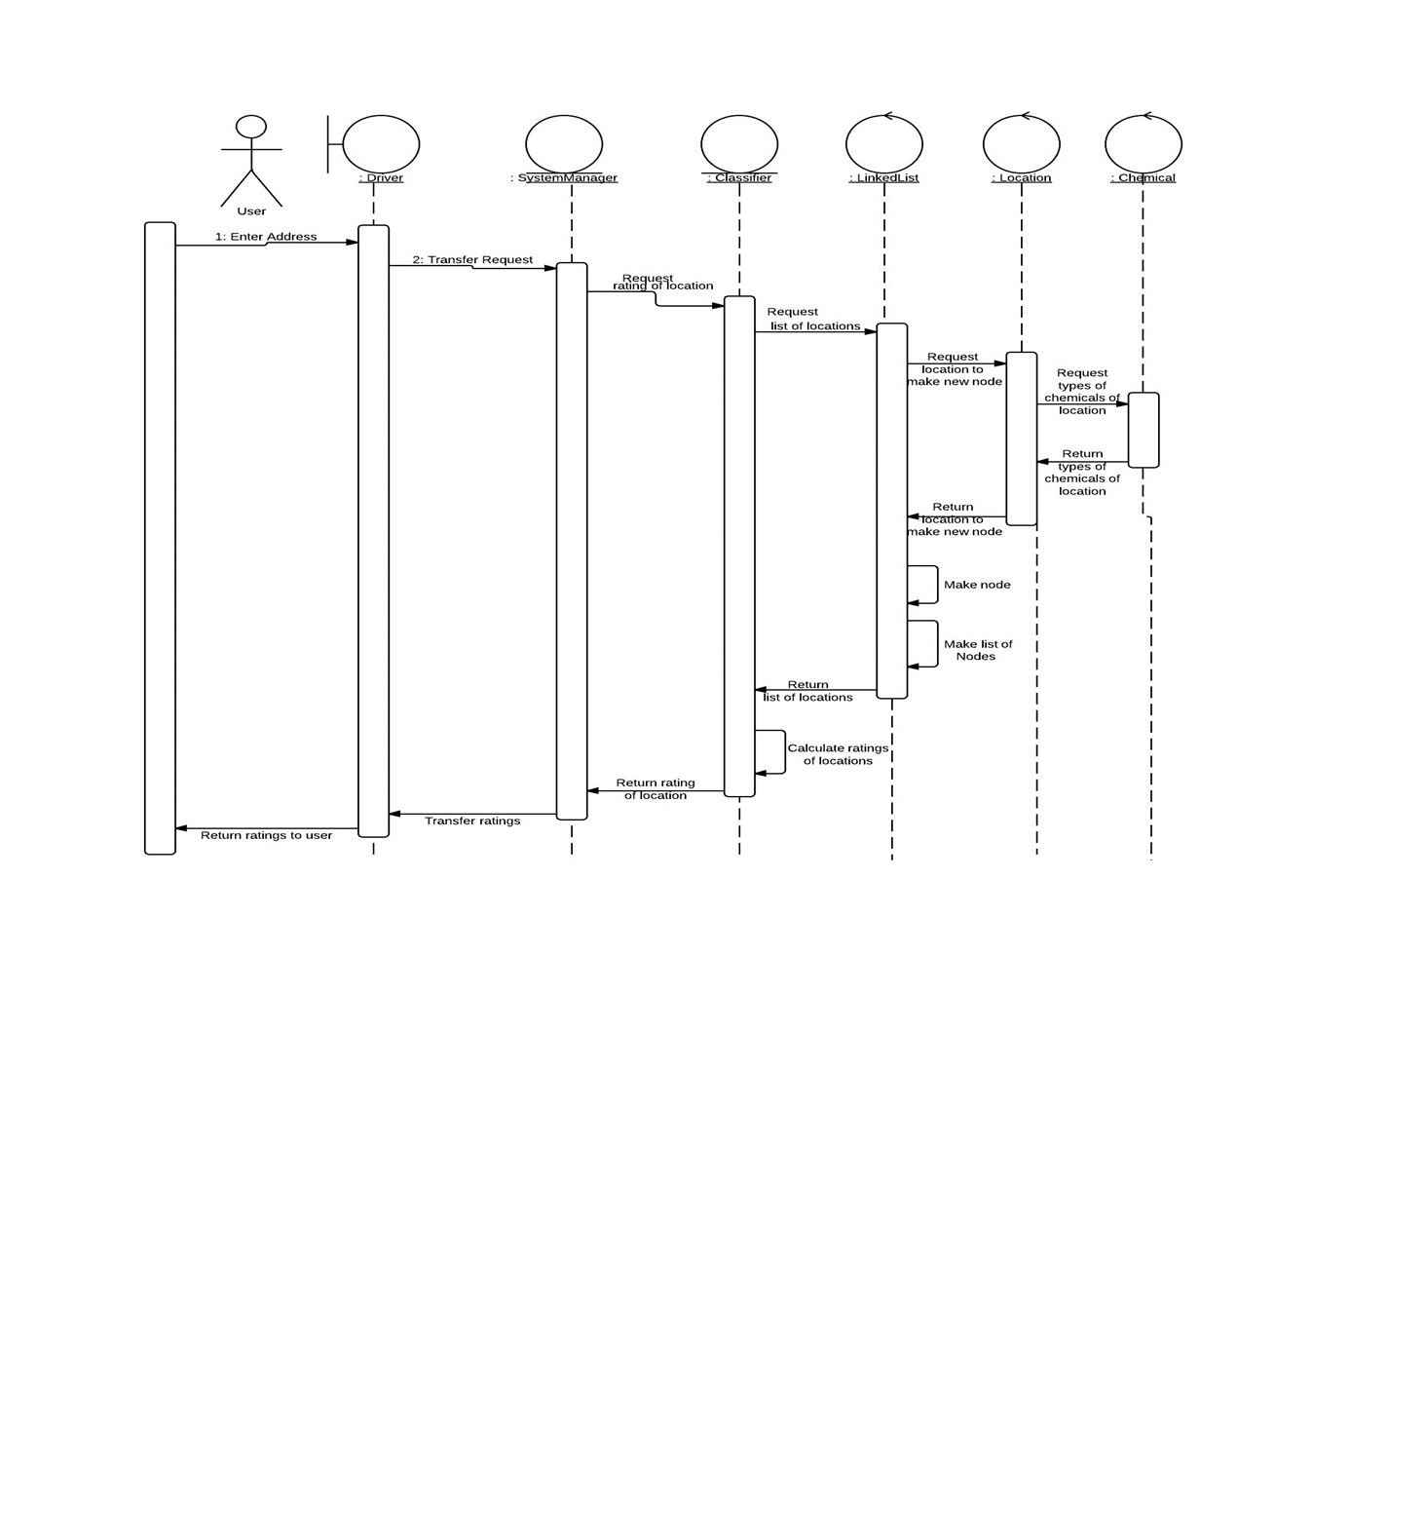

Slide 8
Here’s how it works…

Slide 9
Problems encountered
Geocoding
Connecting front end to back end
Nearest neighbor code from last semester did not work as anticipated

Slide 10
Things we learned
Time Management
Communication
Adaptability
Patience!!

Slide 11
Conclusion
Importance
The potential to discover brownfields before construction begins is incredibly beneficial to the foundation
Saves time and money
Further Improvements
Integrate with database
Improve algorithm further

Slide 12
